Slide 1

Basics of digital Electronics
Department
of
computer Engineering
Name : Veer R Patel
Enrollment Number : 219590307010

Slide 2
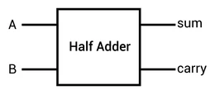
Half Adder
A Combinational circuit that performs the addition of two bits is called a Half Adder .
There are two input terminals A and B.
There are two output terminal one is sum and another is carry .
Input
output

Slide 3
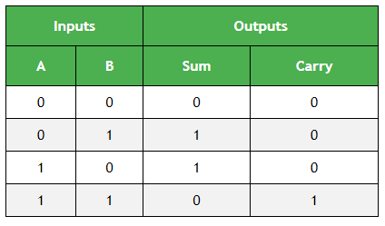
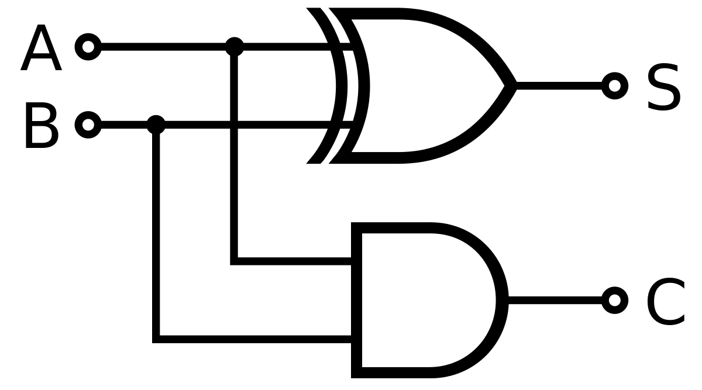
Circuit Diagram and truth table
The Circuit shows that sum can be realized by EX-OR gate and carry can be realized by an AND gate.
Boolean Expression for sum and carry
sum = AB + AB
carry = AB

Slide 4
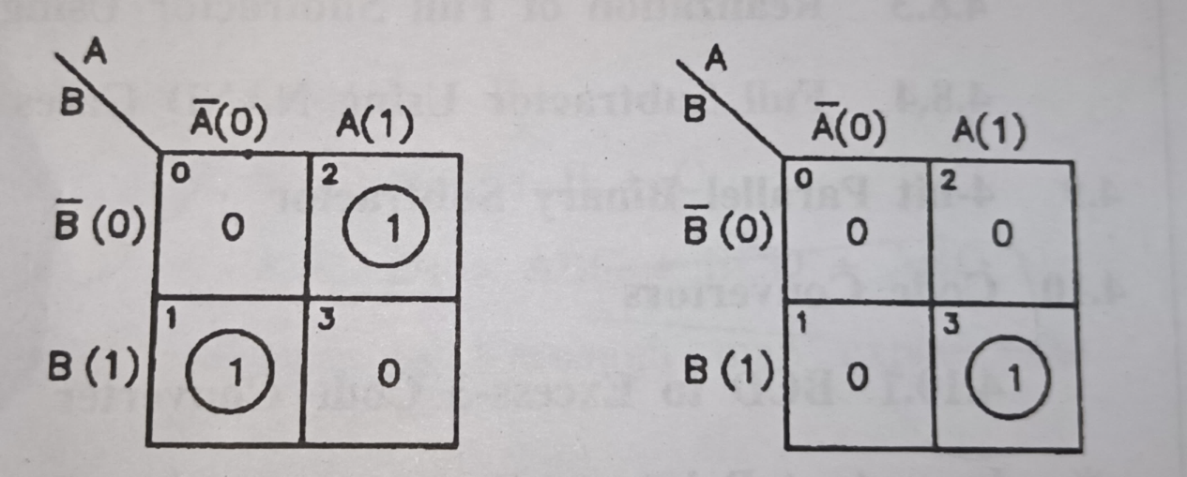
Expression of Half Adder from K-Map
K-map of Half Adder
Boolean Expression of sum from K map
S = AB + AB
Boolean Expression of carry from K map
C = AB
SUM
Carry

Slide 5
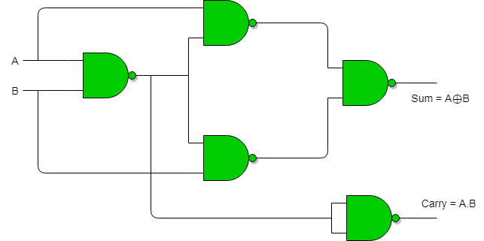
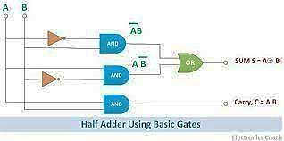
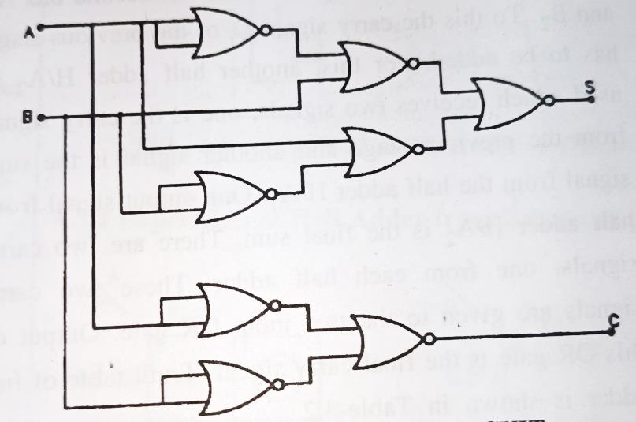
Different circuit of Half Adder
Half Adder circuit can also made with help of different gates they are
Using AND,OR,NOT gates
Using only NAND gate
Using only NOR gate

Slide 6
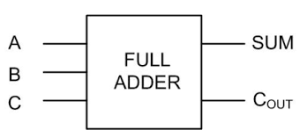
Full Adder
A combination circuit which perform addition of three bits is called Fuller Adder .
There are three input terminal they are two operands and a previous carry bit.
There are two output terminal they are sum and carry.
Input
output

Slide 7
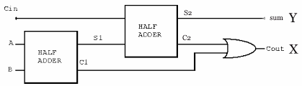
Block diagram of Full Adder
Here Two half Adder and OR gate is use.
One Half Adder makes the sum of A and B and another half adder makes the sum of Cin and the sum of the previous half adder this makes the final sum.
The two output carry from both Half adder is given Input in OR gate and the output of it final carry signal.

Slide 8
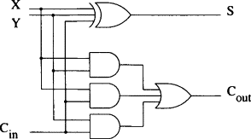
Circuit diagram of Full Adder
There are three input EX-OR gate is used to realize the sum .
To realize carry three 2 input AND gate and one 3 input OR gate is used.

Slide 9
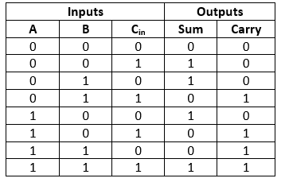
Truth table of full Adder

Slide 10
Boolean expression of Full adder
Boolean expression of sum and carry of Full Adder from logic circuit.
Sum = A ⊕ B ⊕ Cin
Carry = ACin + BCin + AB

Slide 11
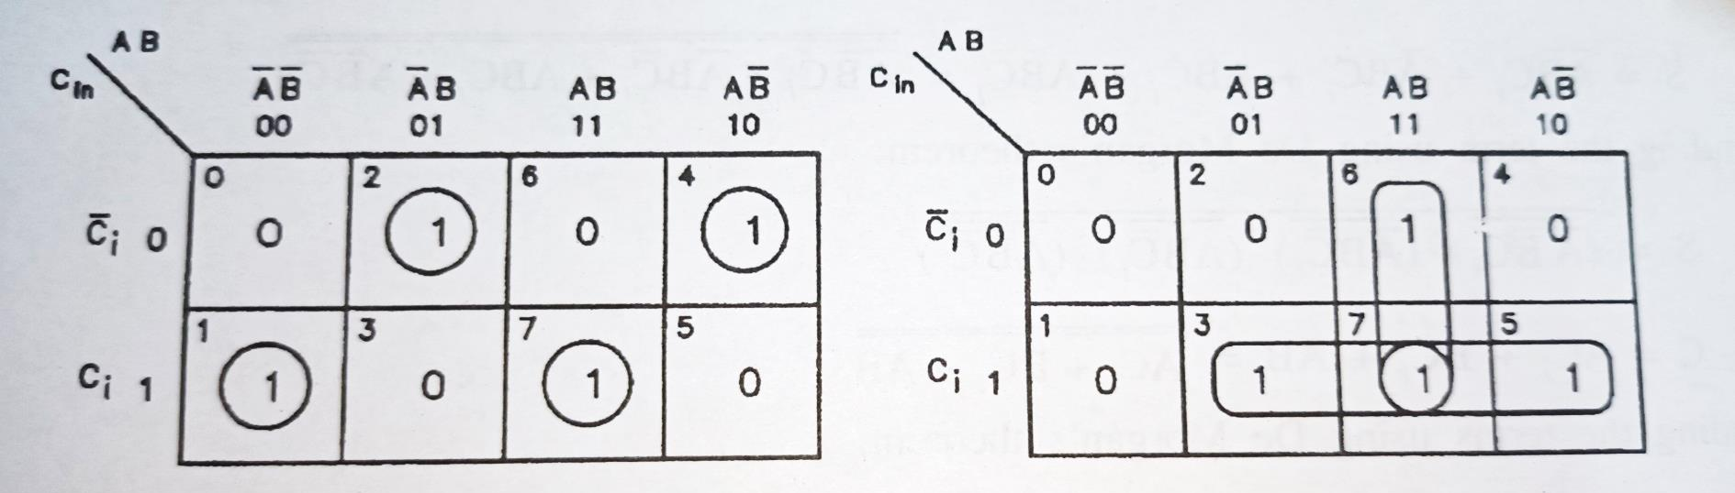
Expression of Full Adder from K-Map
K-map of Full Adder
Boolean expression from Figure
Sum = ABCi + ABCi + ABCi+ ABCi
Carry = ABCi + ABCi + ABCi + ABCi
sum
carry

Slide 12
Simplification of Boolean expression
Simplification of sum
S = ABCi + ABCi + ABCi + ABCi
= Ci (AB + AB) + Ci (AB +AB)
= Ci [A ⊕ B] + Ci [A ⊕ B]
Let A ⊕ B = X ,then
S = CiX + CiX
= Ci ⊕ X
= Ci ⊕ A ⊕ B
S = A ⊕ B ⊕ Ci

Slide 13
Simplification of Boolean expression
Simplification of Carry
C = ABCi + ABCi + ABCi + ABCi
= ABCi + ABCi + BCi( A + A )
= ABCi + ABCi + BCi
Adding the term ABCi twice for Simplification
C = ABCi + ABCi + BCi + ABCi + ABCi
= ABCi + ABCi + ABCi +ABCi + BCi
= AB ( Ci + Ci ) + ACi ( B + B ) + BCi
= AB + ACi + BCi
= ACi + BCi + AB

Slide 14
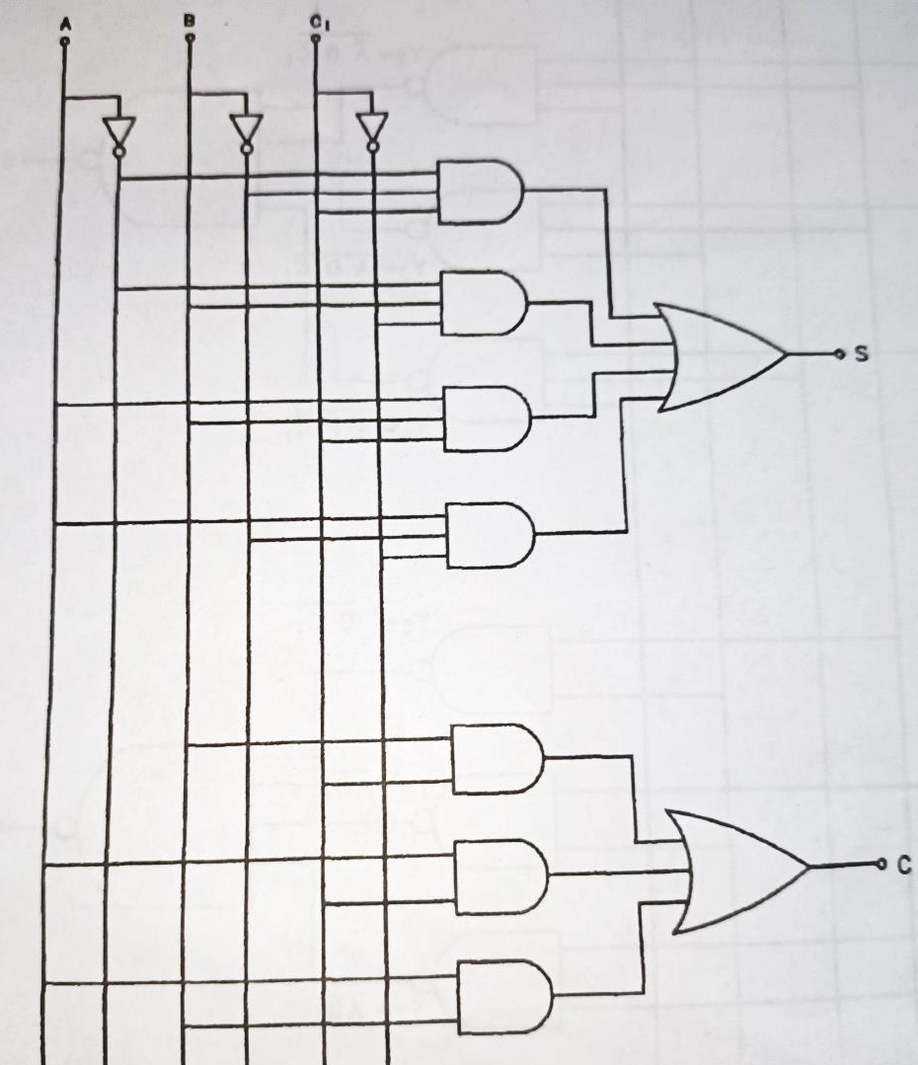
Full adder using different gates
Here AND , OR and NOT
gate is used.
Boolean expression from
Figure
Sum
S = ABCi + ABCi + ABCi+ ABCi
Carry
C= ACi + BCi + AB

Slide 15
Full Adder using NAND gate
Full Adder using NAND Gate
S = ABCi + ABCi + ABCi + ABCi
= ABCi + ABCi + ABCi + ABCi
= ( ABCi ).( ABCi ).( ABCi ).( ABCi )
C = ACi + BCi + AB
= ACi + BCi + AB
= (ACi ).( BCi ).( AB )

Slide 16
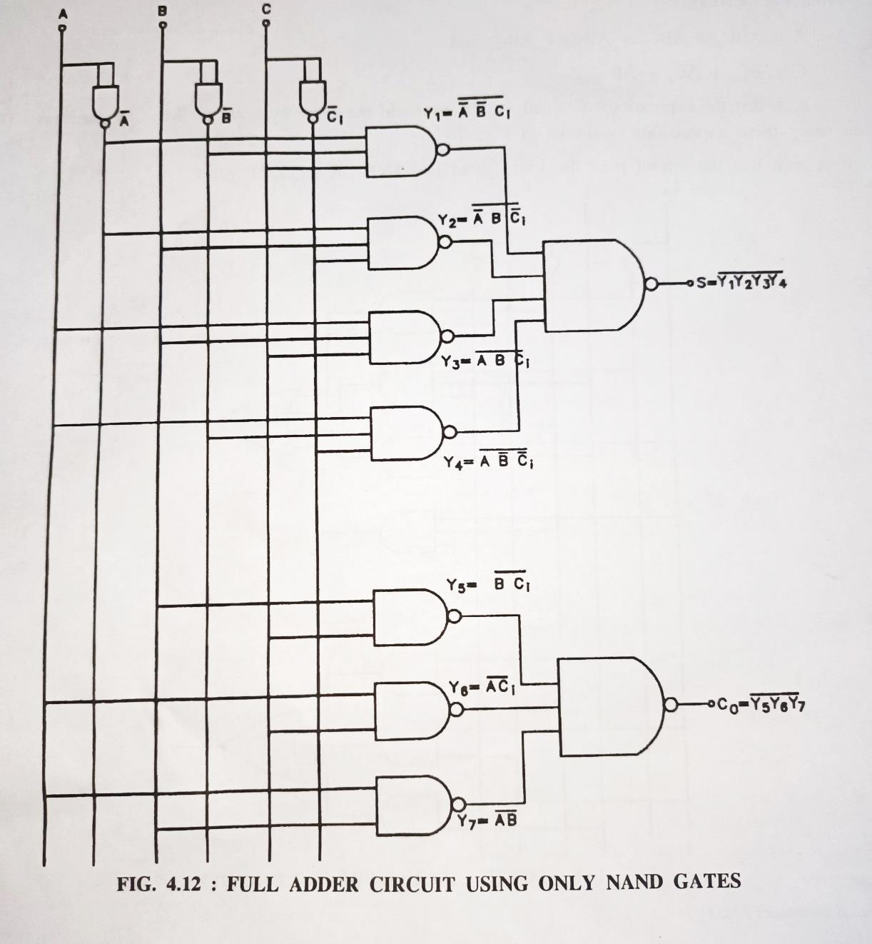
Full Adder using NAND gate

